Slide 1
Approximate communication: Techniques for reducing communication bottlenecks in large scale parallel systems
BY Filipe Betzel, karen khatamifard, harini suresh, David j. lilja, john sartori, ulya karpuzcu (university of Minnesota)
Presented by Alex wright

Slide 2
The big questions
What type of Approximation are we looking at?
Communication, with a primary focus in communication bottlenecks in large-scale parallel systems
What is the strategy?
3 different types are addressed
Compression-to reduce bandwidth utilization and improve energy efficiency
Relaxed synchronization- improved scalability
Value prediction- improved overall performance of the system
How?
Compression- Trading accuracy of information for improved energy efficiency
Relaxed synchronization- trading quality for speed and parallelism
Value Prediction- trading accuracy for performance improvement

Slide 3
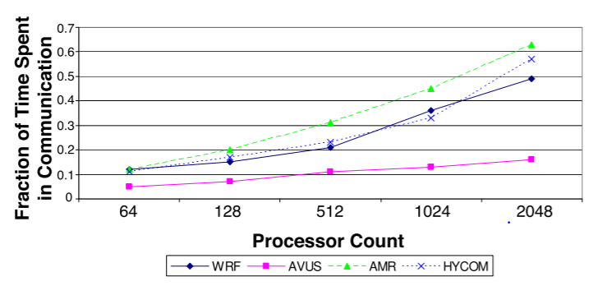
Overview
What is the problem we are trying to solve?
In attempting to reach peak performance, finding scalable parallelism isn’t compatible with any substantial amount of communication or synchronization between processing elements
In many highly parallel machines peak performance is obtained with extraordinarily high communication to computation ratios
Amdahls law shows that the more parallelism you introduce, time spent in communication exponentially increases
Communication is costly for power( typically taking 10-20%)

Slide 4
Strategy 1:Compression overview
Compression reduces the need for higher bandwidth and improves energy efficiency by removing redundant data and can be optimized for certain applications
Compression is classified based upon output fidelity
Lossless or Lossy purely determined based on application
Compression results/research/challenges:
Compression itself can introduce latency but still reduces packet latency and energy requirements
Can also be applied to perform cache compression to reduce the cache-miss rates.
Improves performance by up to 40% with adaptive applications

Slide 5
Lossless compression V. Lossy Compression
Lossless | Lossy
Encoding the data so that it maybe transmitted in a precise fashion. Can be statistical or dictionary-based compression Statistical Uses the probability of occurrence to assign symbols codes(Huffman or Arithmetic encoding) Assigning shorter codes to common symbols and longer to more rare messages Dictionary-based Uses a dictionary of symbols to scan the inputs and if there is a match the string is replaced with a reference to the dictionary(token) Results in better compression ratios Used for GIF files | Approximation of the inputs to remove irrelevant data Predictive coding Predicts the current sample from the previous sample Can be used for DFT,DCT, and DWT signals with minimal output quality degradation Ideal applications for images, video, and audio because the degradation of the output is not likely to be of consequence.

Slide 6
Compression with communication
Link compression can be applied to band-width constrained data
By compressing the links it frees up extra bandwidth constructed such that the system can dynamically change to the compression algorithm based on the systems needs.
Compression with GPUS
With GPUS they address the memory bandwidth as well as the compute v. memory resource imbalance bottleneck and seek to fix it with a memory controller that performs the compression on the messages. By utilizing the memory controller we
EX: Warped compression reduces the file bank accesses and in doing so, saves power(appx. 8% on average)
Compression and Parallel Systems
Bui et. al[20] is a study that utilizes compression, topology-aware data aggregation, and subfiling to improve the performance of the BlueGene/Q supercomputer. The researchers found that compression improved performance by 40% on its own.
Currently the community is trying to address the expensive relation of communication to computation as we move to more parallelism
Request for investigation into aggressive lossy compression to recognition, mining, and synthesis

Slide 7
Strategy 2: Relaxed synchronization overview
Relaxed synchronization is a purely software implementation used to reduce dependencies of parallel tasks and prevent conflicts of parallel tasks.
Some examples:
Relaxed speculative synchronization
Relaxed protected code sections
Challenges:
Removing as many synchronization points as possible without going beyond acceptable error
Which serialization points can be relaxed?
The more parallel the application becomes the more synchronization takes up overhead.
Notes:
This slide is too wordy. Simplify the definition for relaxed synchronization. So relaxed synchronization basically means either reduce amount of parallelism (dependencies among parallel tasks) or restrict access to only one parallel task at a time (preventing conflict).

Slide 8
Strategy 3: Value prediction overview
Value Prediction exploits the predictability of data values to allow processors to continue down the pipeline without having to wait for true data values to be confirmed.
2 types of value predictors
Computational predictors- IE last value and stride predictors
Context-based predictors- found to have accuracy around 56-92% accuracy.
Challenges:
In implementation there must be both a high accuracy value predictor as well as a rollback mechanism in the case of a bad prediction
This increases complexity and power consumption
Predictor tables are expensive

Slide 9
Value prediction in parallel systems
Reformulation of Amdahls law has shown improvements up to 267%(PARSEC and SPLASH-2 benchmarks)
Value prediction may also be used to improve the performance of Thread-level speculation to automatically parallelize the sequences of code that were not previously parallel
Value predictors are often created with hardware. Problem: Value prediction struggles with multi-threaded architectures.
Notes:
You can break this slide into two and remove the lines (Allows for….) and (Value prediction may also be…)

Slide 10
Strategy Summary
 | Compression | Relaxed Synchronization | Value prediction
Cost Reduction | Reduces size of messages | Reduces number of messages | Reduces number of messages
Performance | -dependent on bandwidth with possible output degradation | -dependent on overhead with no degradation | -improves in programs with large latency with no output degradation
Energy Reduction | -depends on the compression ratio | -depends on reduced execution time | - Depends on approximation degree
Applicability | -Application specific | -Application specific | -Application Agnostic
Overhead | Compression and decompression time | Programmer effort | Chip area and power
Output degradation | Controllable with compression ratio | Controllable with selection of synchronization points | Controllable with changing approximation degree
Notes:
This table is overwhelming. So just paint over some key points.

Slide 11
Approximation strategies and how they effect communication
Notes:
Also paint over some key points here.

Slide 12
Questions
How can Approximate computing be used to improve communication in parallel systems?
A) Reducing the number of messages
B) Reducing the size of the messages
C) Both A and B
D) None of the above
Compression is…(Select the best answer)
A) Domain specific
B) Capable of freeing up bandwidth
C) Performed in hardware
D) All of the above
Synchronization points…( Select the false statement)
A) Contribute to communication overhead
B) Are also serialization points
C) Dictate the order of parallel tasks
D) None of the Above

Slide 13
Questions
How can Approximate computing be used to improve communication in parallel systems?
A) Reducing the number of messages
B) Reducing the size of the messages
C) Both A and B
D) None of the above
Compression is…(Select the best answer)
A) Domain specific
B) Capable of freeing up bandwidth
C) Performed in hardware
D) All of the above
Synchronization points…( Select the false statement)
A) don’t contribute to communication overhead
B) Are also serialization points
C) Dictate the order of parallel tasks
D) None of the Above

Slide 14
Questions?

